Slide 1
What are Hackers up to?
- a story of technical manipulation and wizardry

Slide 2
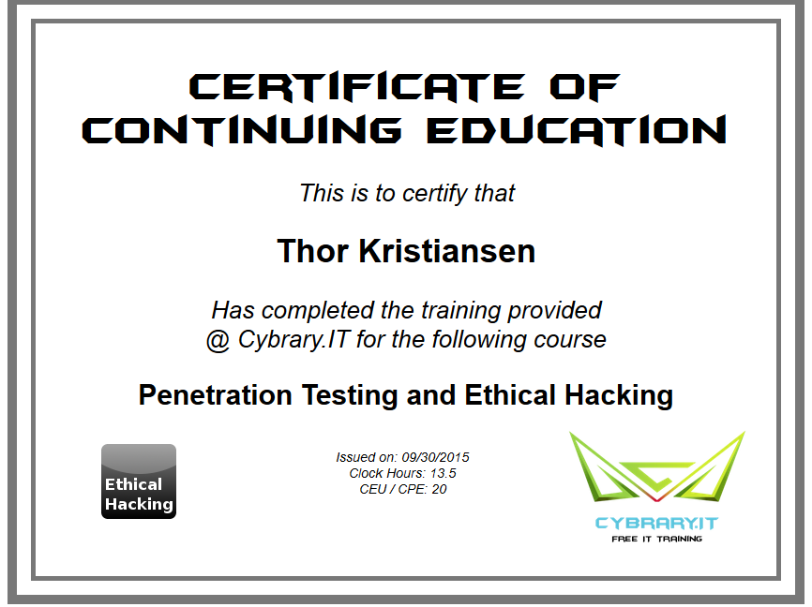
$Whoami
CS & IT Graduate
Founder of CPH:SEC formerly KEA pen-test Club
Cybrary.IT ”Penetration Testing & Ethical Hacking” certified

Slide 3
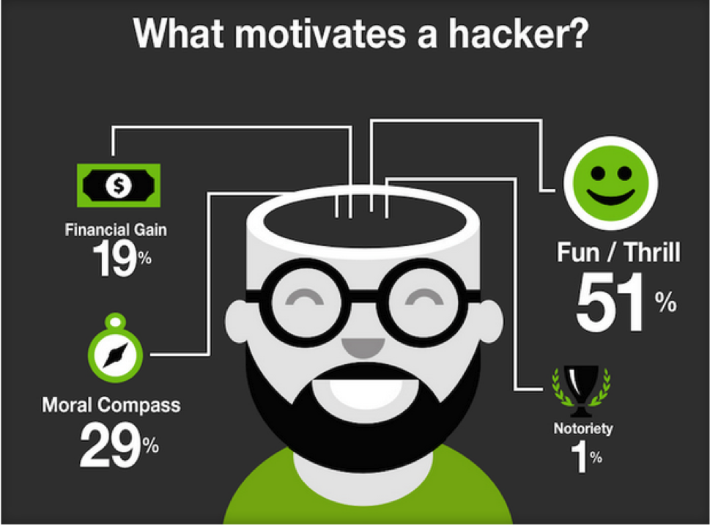

Hacker Types & Motivation

Slide 4
The Hacker Perspective -Technical Manipulation
“I don’t think hacking is an outgrowth of digital technologies. I believe we can trace its origins all the way to the primordial genesis of our bipedal ancestors. It is an inborn spark, an inherent element of consciousness. A meta-program or sub-routine which developed as a high-level adaptation during the burst of human evolution. The ephemeral instinct expressed as curiosity, that desire to know and interact within one’s own terms; even today these traits have taken a hand in shaping the future. If you have read your McLuhan, you know that the various shapes and forms of technology are externalizations and outward projections of consciousness. Consider then, the latent power of pushing the envelope in every direction. “ - 2600

Slide 5
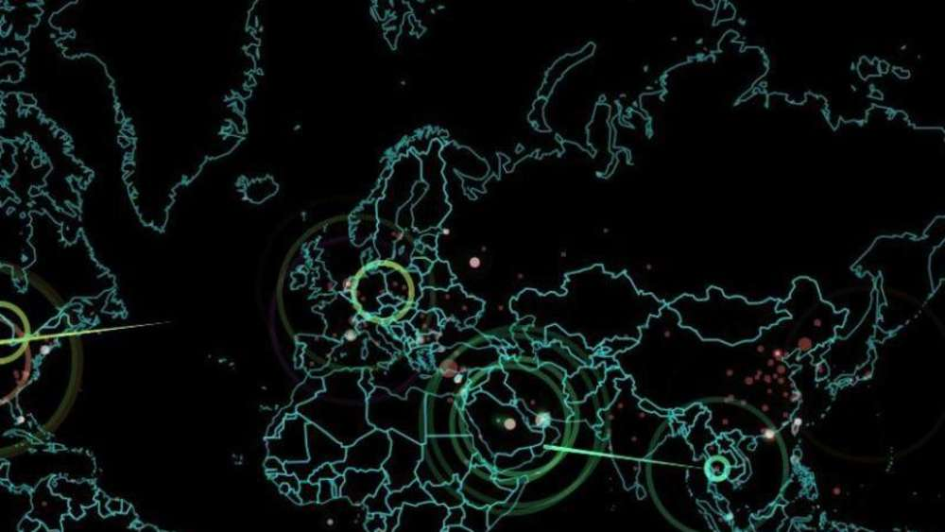
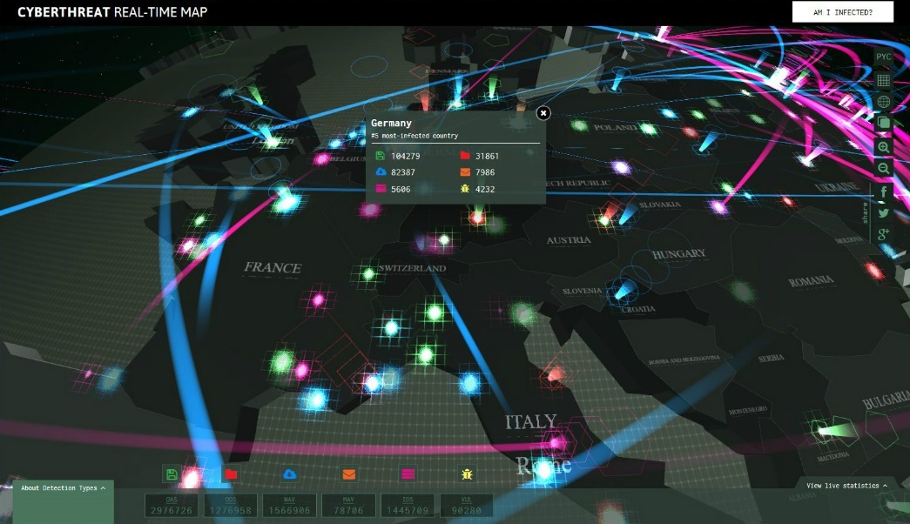
Live Hacking Maps
Norse DDOS
Kaspersky Cyber War Map

Slide 6
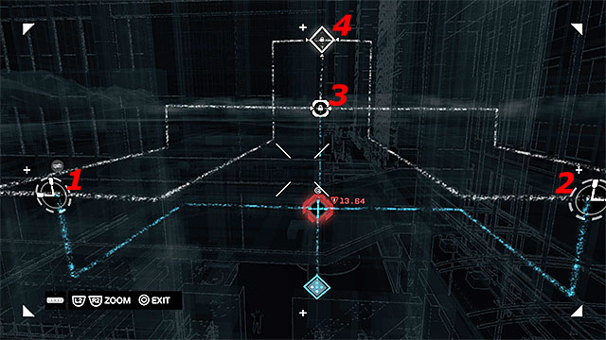
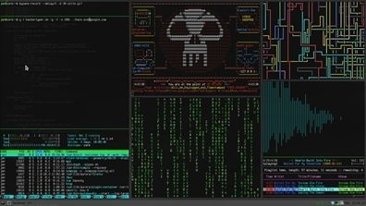
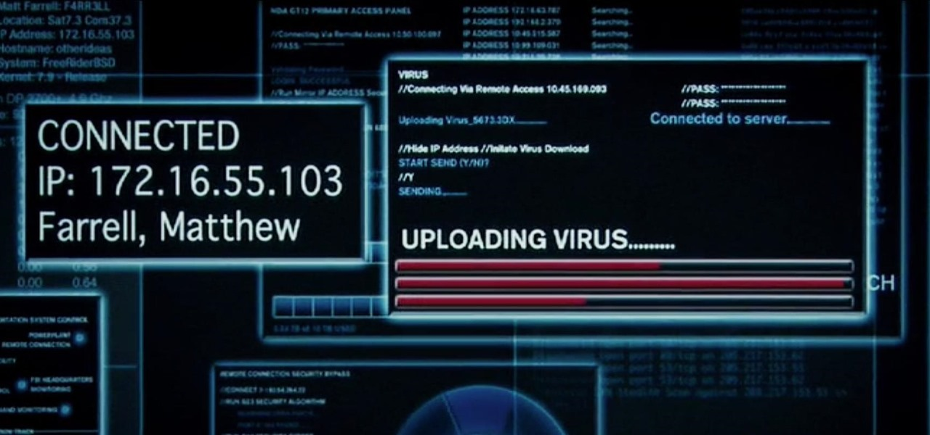
Hacking in Movies & Games

Slide 7
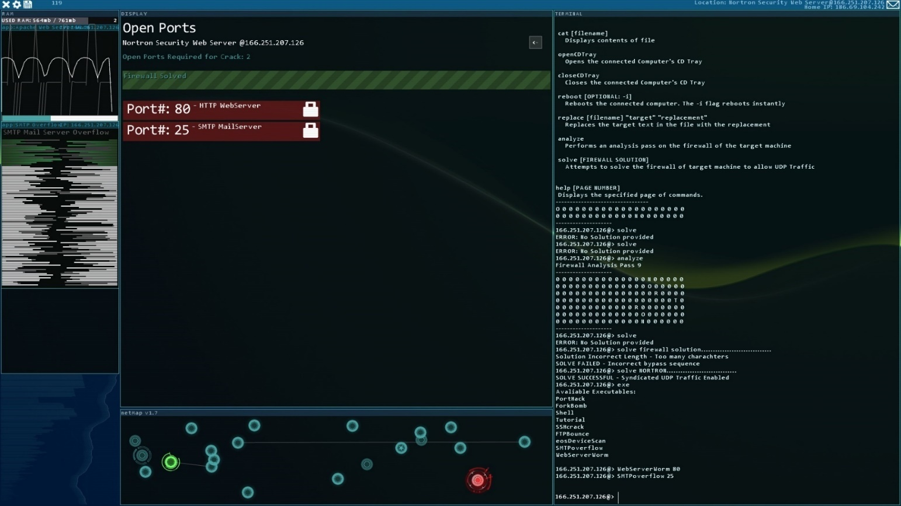
Hacknet OS
- Hacking Simulation Game

Slide 8
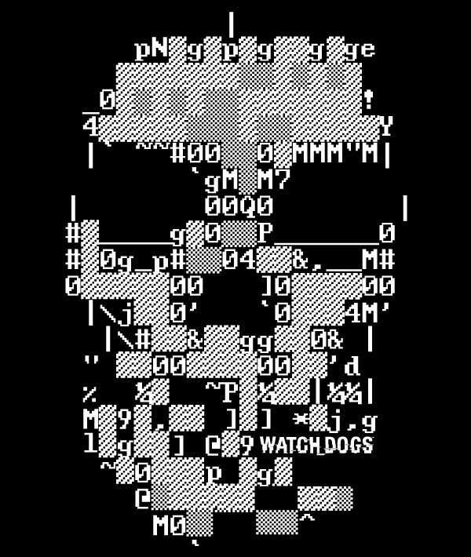
Reality – A Real Hack
Intelligence Gathering
Network Access
Network Analysis
Applying Exploit
Post Hack

Slide 9
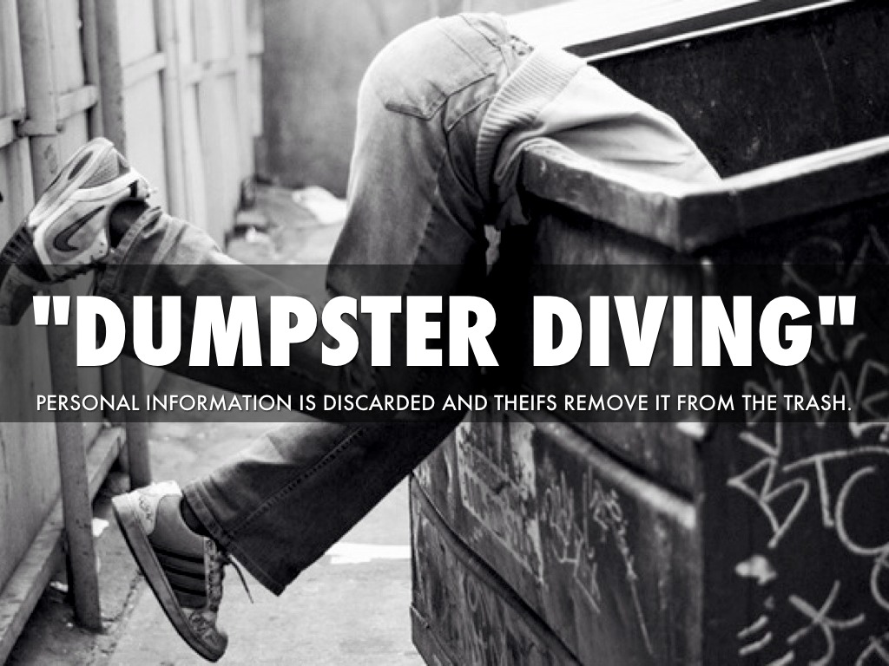
Intelligence Gathering
Google
Website
Marketing Information
Dumpster Diving
Covert Gathering
Individual eg. Social Network

Slide 10
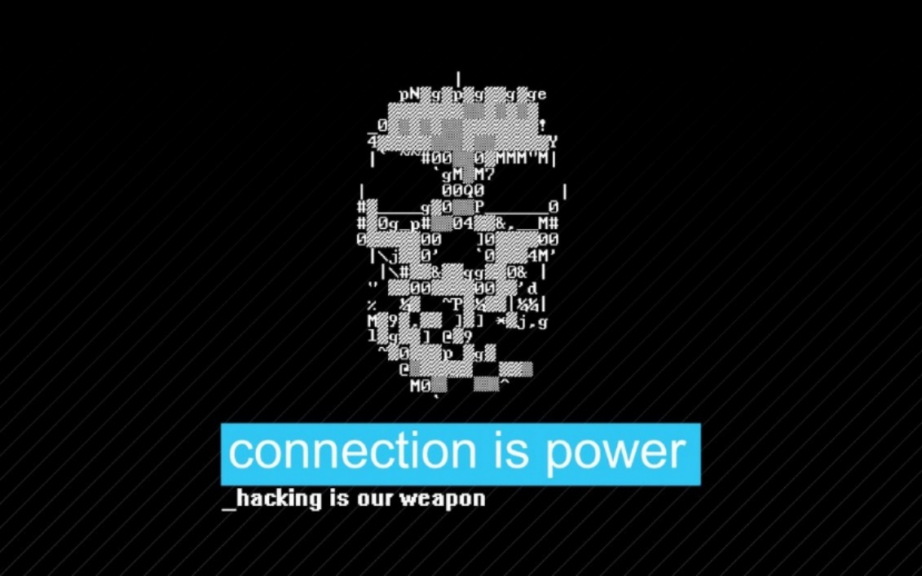
Network Access

Slide 11
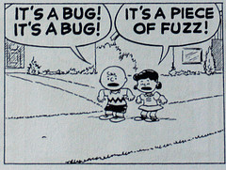
Fuzzing
A fuzzer would try combinations of attacks on:
- numbers (signed/unsigned integers/float...)
- chars (urls, command-line inputs)
- metadata : user-input text (id3 tag)
- pure binary sequences
A common approach to fuzzing is to define lists of "known-to-be-dangerous values" (fuzz vectors) for each type, and to inject them or recombination's.
- for integers: zero, possibly negative or very big numbers
- for chars: escaped, interpretable characters / instructions (ex: For SQL Requests, quotes / commands...)
- for binary: random ones

Slide 12

Buffer Overflow
A buffer overflow occurs when data written to a buffer also corrupts data values in memory addresses adjacent to the destination buffer due to insufficient bounds checking.
This can occur when copying data from one buffer to another without first checking that the data fits within the destination buffer.

Slide 13

Network Analysis
NMAP
HPING3
SPARTA
Dmitry
Sn1per.py

Slide 14
$man ”what are hackers up to”
Wifite Recon
inSSIDer
Wifite
airmon-ng
airmon-ng start wlan0
airodump-ng wlan0mon
wifite -b <bssid> -aircrack
aircrack-ng -b <bssid> -w password.list dumpfile.cap
Firewall
nmap --script=firewalk --traceroute 192.168.20.2
hping3 -S 192.168.20.2 -c 100 -p ++1
sfuzz -v -S 192.168.80.170 -T -p 8080 -f /usr/share/sfuzz/sfuzz-sample/basic-fuzz-strings.list
Network Discovery
NMAP
sparta
dmitry -w -i -n -s -e -b -p -f kea.dk
sn1per

